Slide 1
Uber Fares Dataset Analysis using Power BI
Course: INSY 8413 – Introduction to Big Data Analytics
Instructor: Prof. Eric Maniraguha
Student: Nshuti mugabo arsene
Date: July 2025

Slide 2
Introduction
• Goal: To analyse uber ride fare data to uncover useful business insights using python and power BI.
• Tooling: Python (Jupyter) for data prep, Power BI Desktop for modeling and visualization.
• Deliverables: Interactive dashboard (.pbix), report (this deck), cleaned CSV, GitHub repo, screenshots.

Slide 3
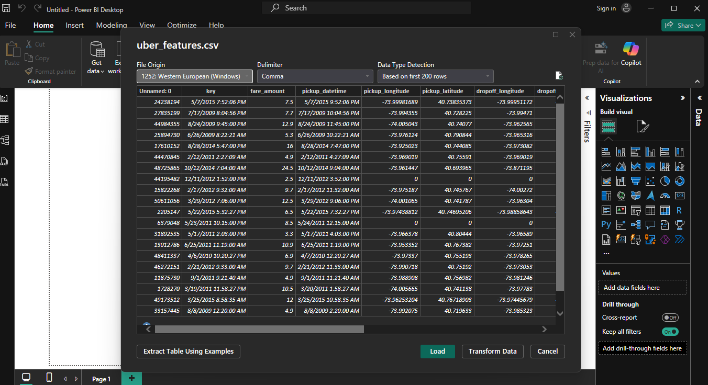
Dataset Description
• Source: Kaggle – Uber Fares Dataset
• Key fields: fare_amount, pickup_datetime, pickup_longitude/latitude, dropoff_longitude/latitude, passenger_count, etc.

Slide 4
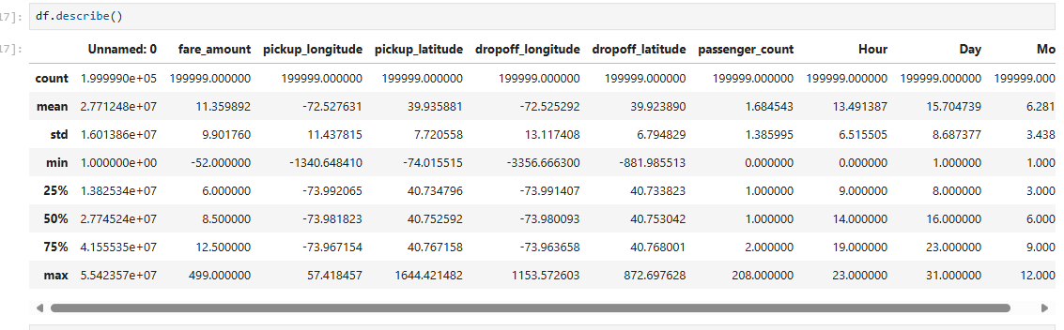
Data Understanding (Initial EDA)
• Checked structure, data types, unique values, missingness.
• Summary statistics (mean, median, std, IQR) for fare_amount & distance.
• Identified outliers & invalid coords.

Slide 5
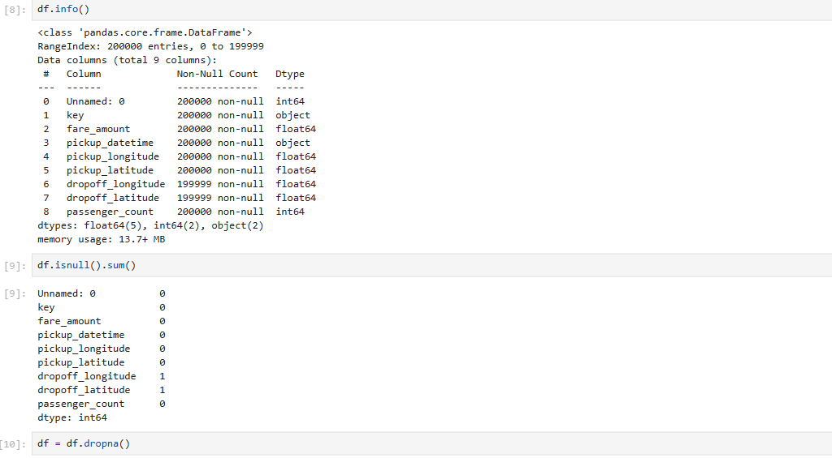
Data Cleaning (Python / Jupyter)
Steps performed:
1. Removed/filtered impossible fares (e.g., negative or 0, extremely high)
2. Removed coordinates outside valid NYC bounds (if applicable)
3. Handled missing values (dropped / imputed)

Slide 6
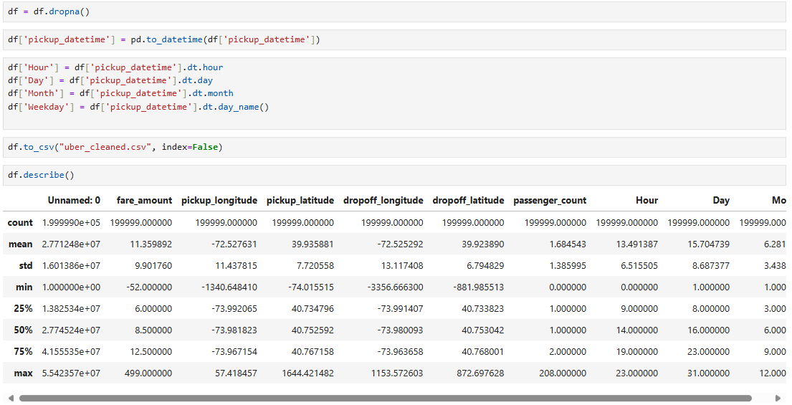
Feature Engineering
Created features:
hour, day, month, weekday extracted from pickup_datetime
Saved enhanced CSV for Power BI import.

Slide 7
Export to CSV
Final cleaned & engineered dataframe exported to: uber_features.csv

Slide 8
Power BI – Data Import
Imported the cleaned CSV into Power BI

Slide 9
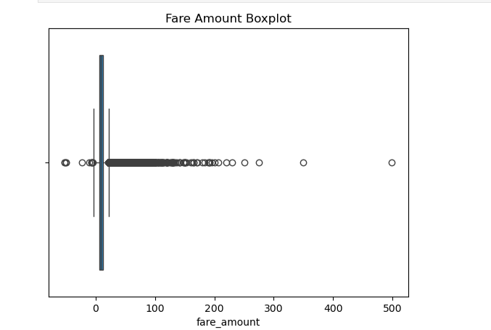
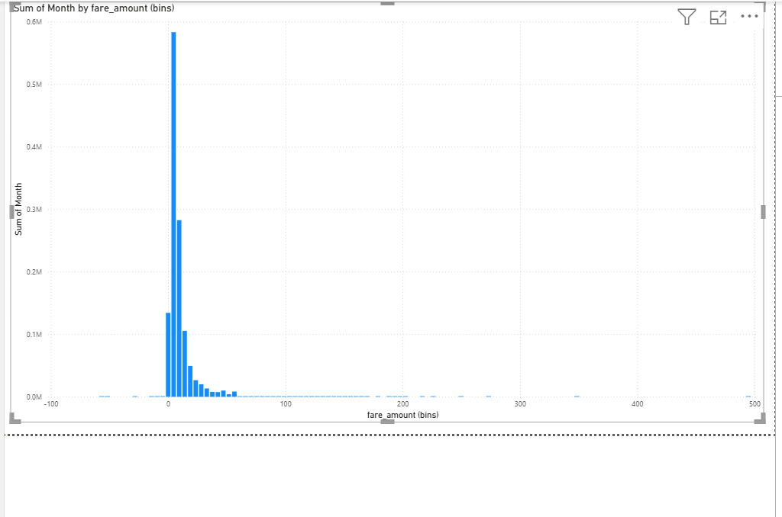
Fare Distribution
• Histogram of fare_amount to inspect central tendency & skewness
• Box plot to detect outliers

Slide 10
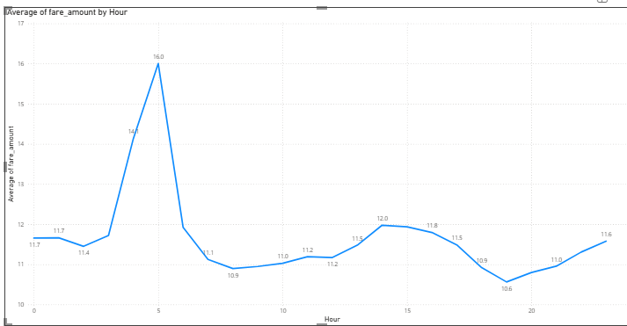
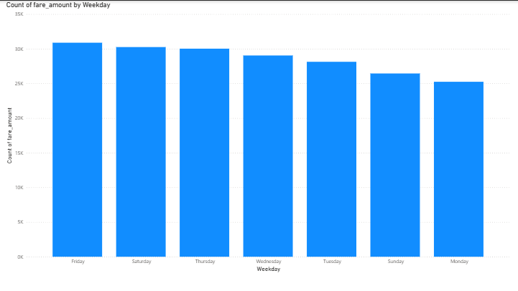
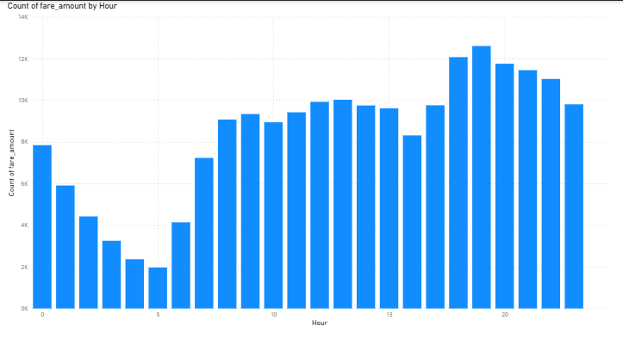
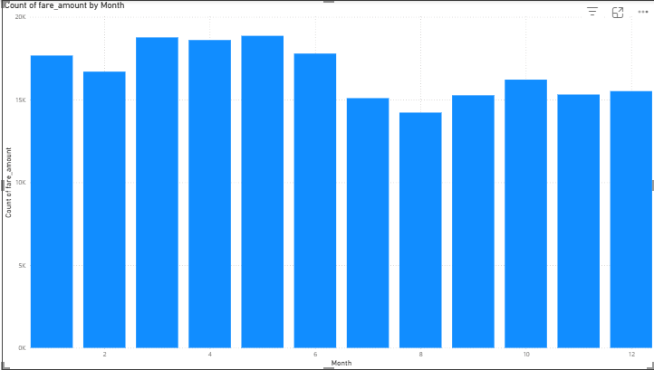
Time-based Trends
• Average fare by hour (line chart)
• Ride volume by hour/day/month
• Day of week comparison (weekday vs weekend rides/fare)

Slide 11
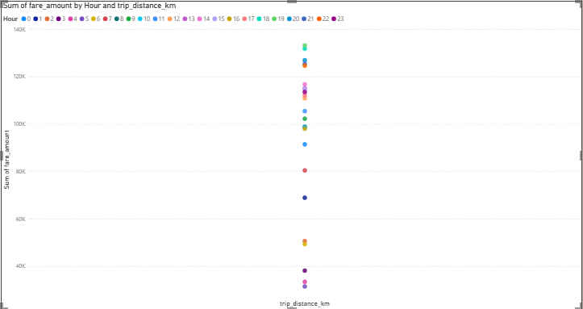
Fare vs Distance (Correlation)
• Scatter plot: fare_amount vs distance_km
• Trend indicates strong positive correlation
• Potential heteroscedasticity at long distances

Slide 12
Busiest Periods Identification
• Hours with highest number of rides
• months with most activity
• Peak vs Off-peak segmentation

Slide 13
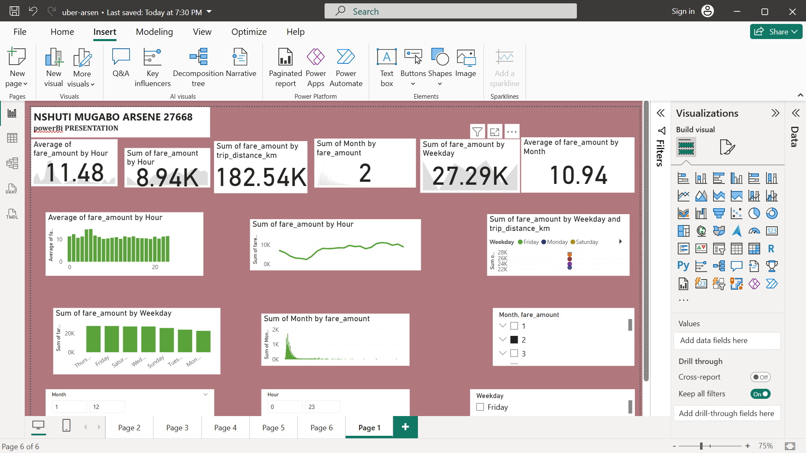
Dashboard Design & Interactivity
Design principles applied:
• Clear layout: KPI on top, trends & distribution center, filters bottom
• Slicers: month, weekday, hour
• Consistent formatting (Theme, colors, fonts)

Slide 14
Insights / Results
The analysis of Uber fares shows that most rides are within the $5–$15 range, with outliers above $50. The fare distribution is right-skewed with a median fare around $8–$10. Ride demand peaks during the morning (6–9 AM) and evening (4–7 PM) commuting hours, as well as on weekends, particularly Fridays and Saturdays. Average fares rise late at night, likely due to longer rides or surge pricing. Monthly patterns indicate that [replace with busiest month] has the highest ride volume, suggesting seasonal demand variations. The fare vs. distance scatter plot confirms a strong positive correlation, where longer trips naturally lead to higher fares, though fare variability increases with distance. Based on these insights, it is recommended to implement dynamic pricing during peak periods, offer targeted promotions during off-peak hours, and validate any outlier fares above $50 to ensure data accuracy.

Slide 15
conclusion
The Power BI dashboard provides a clear view of fare distribution, time-based trends, and fare-distance relationships. These insights can support better decision-making for pricing strategies and operations. Further improvements can be achieved by integrating external factors like weather and event data.

Slide 16
Recommendations
1. Implement surge pricing during peak hours (6–9 AM, 4–7 PM) and weekends.
2. Provide discounts or loyalty rewards during off-peak periods to balance demand.
3. Monitor outlier fares and anomalies to ensure data quality.
4. Explore adding weather and seasonal event data for deeper insights.

